Slide 1





OPTIMIZING SPAM FILTERING USING MACHINE LEARNING

Slide 2
Government arts and science collage perumbakkam, chennai - 600131

Slide 3
Abstract :
The main objective of this project is to avoid the congestion the message was spam didection.
This is project was using to find a massage is fake or true.
Then project was very useful for people’s safety.
Project was helpful for future predictions.
Then we are using mission learning then analysis the data set verify the data and exploring comment then giving a massages.
That massage was predict for giving massage is true of fake.
The giving massage was true then predict a massage was “The massage was not spam”
The giving massage was false then predict a massage was ”The massage was fake”.
Project was helpful for future predictions

Slide 4
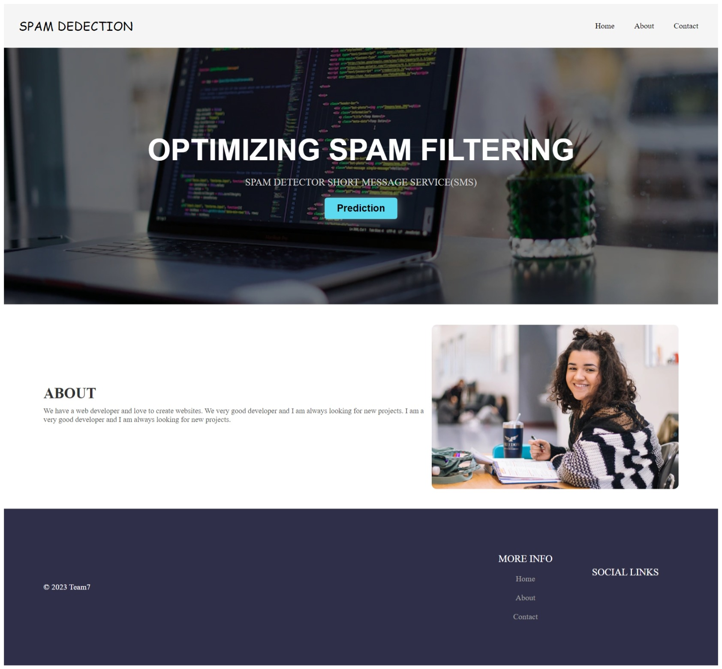
SCREEN SHOTS

Slide 5
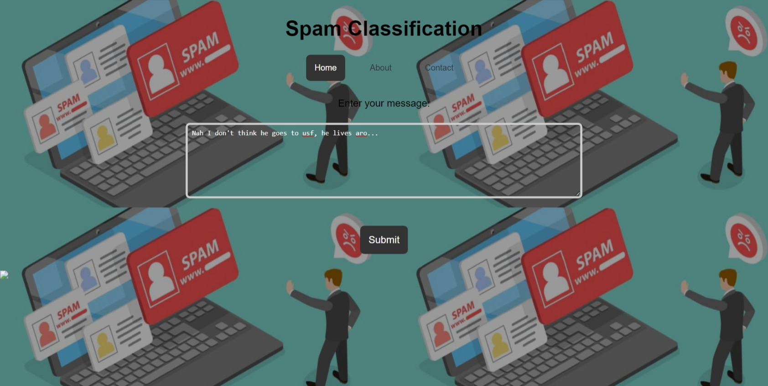

Slide 6
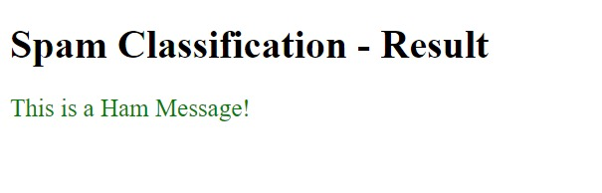

Slide 7
Conclusion :
Present reviews on supervised machine learning strategies for spam filtering
The concluding that name bays method provides faster result and decent presentation overall other methods from all the techniques discussed.
They concluded that the naive bays method provides faster result and decent precision over all other method from all the techniques discussed.
A spam filter server detects un solicited and unwanted email and wipes them out from a user’s mailbox.
Different spam filters have various mechanisms for segregation spam from legitimate emails; however, they all strive to attain a common goal – making sure that only genuine and informative emails reach the end-user

Slide 8


